Slide 1

HR ANALYSIS
Group 5:
Ashish Sawant
Sanika Patil
Mohammad Wasim Shaikh
Sourav Mondal
Sujal Utekar

Slide 2

INDEX
KPI 1 : Average Attrition rate for all Departments
KPI 2 : Average working years for each Department
KPI 3 : Attrition rate Vs Monthly income stats
KPI 4 : Attrition rate Vs Year since last promotion relation
KPI 5 : Average Hourly rate of Male Research Scientist
KPI 6 : Job Role Vs Work life balance
Excel Dashboard
Tableau Dashboard
Power BI Dashboard 1&2
Challenges
Summary

Slide 3
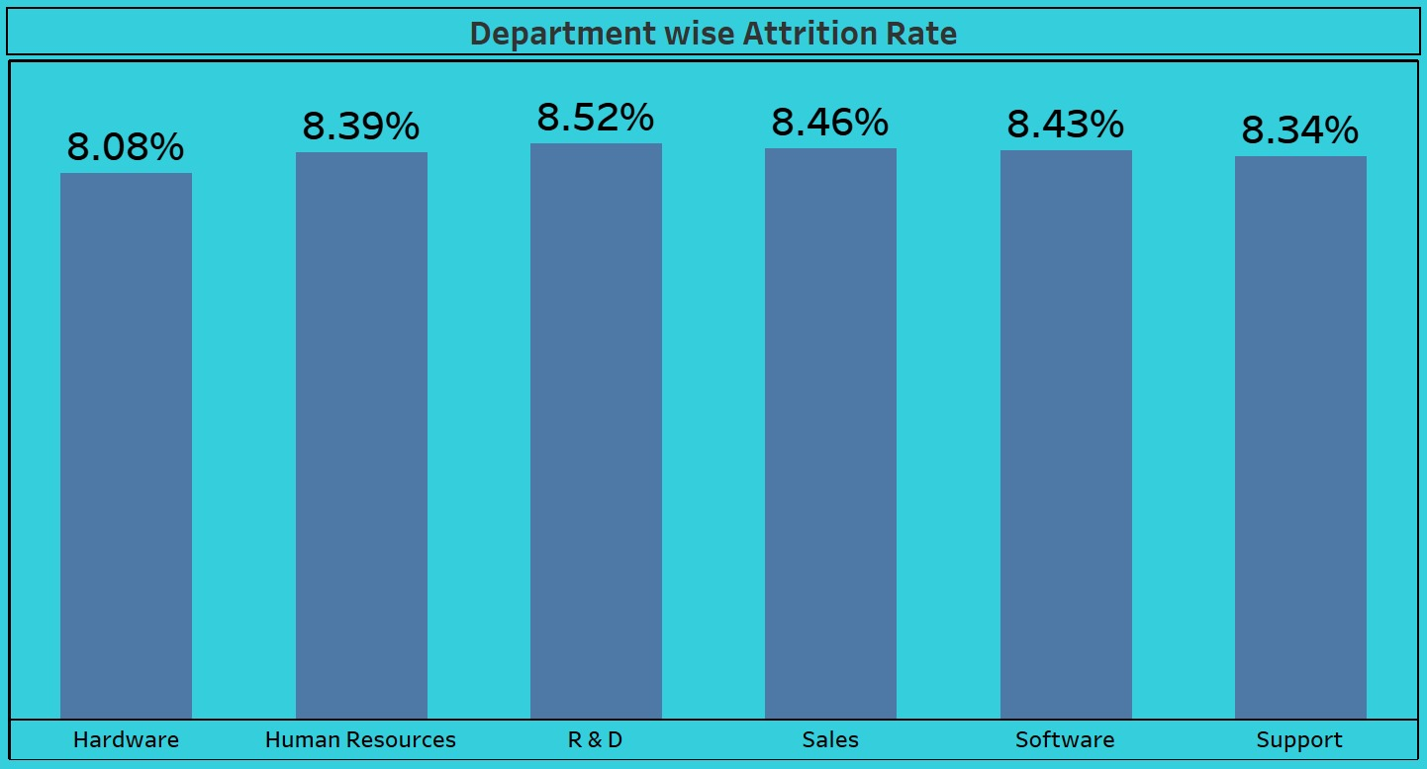
KPI 1: Average Attrition Rate for All Departments
Observation:
Varied Attrition Rates Across Departments:
Min:Hardware department: 8.08% attrition
Max:R&D department: 8.52% attrition.
Job Role Impact on Attrition:
Managers show higher attrition than executives
in hardware and R&D.
Conclusion:
Analyze departmental and role-specific attrition.
Prioritize managerial roles in hardware and R&D

Slide 4
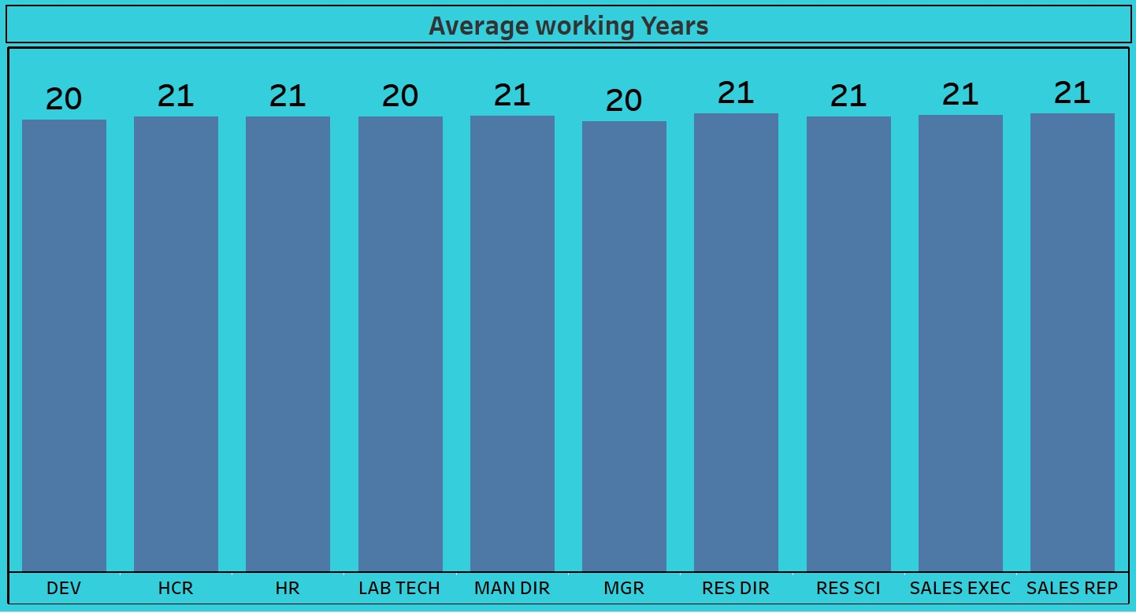
KPI 2:Average Working Years for Each Department
Observation:
Working Years Disparity Across Departments:
Sales: Avg. 21 years,
R&D: Avg. 19 years
Avg and Experience Dynamics
Sales: High average
R&D: Lower average
Conclusion:
Acknowledge diverse tenure for tailored HR strategies
Implement retention initiatives for experienced sales staff

Slide 5
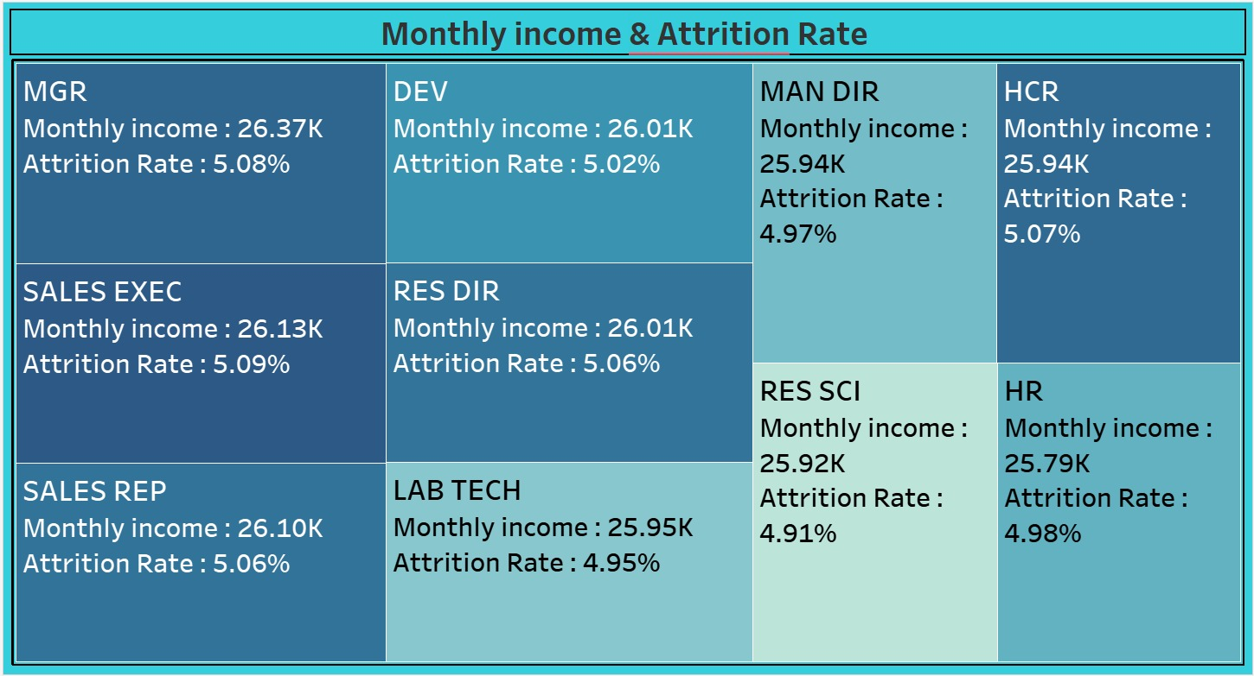
KPI 3:Attrition Rate vs Monthly Income
Observation:
Consistent Attrition Rates Despite Income Variation:
Attrition remains 8-8.5% despite income differences
(25k-26k).
Income Not Sole Determinant of Attrition
Consistent attrition across incomes implies non-monetary factors play a crucial role.
Conclusion:
Beyond competitive compensation, other factors impact retention.
Implement holistic strategies addressing diverse employee needs.

Slide 6
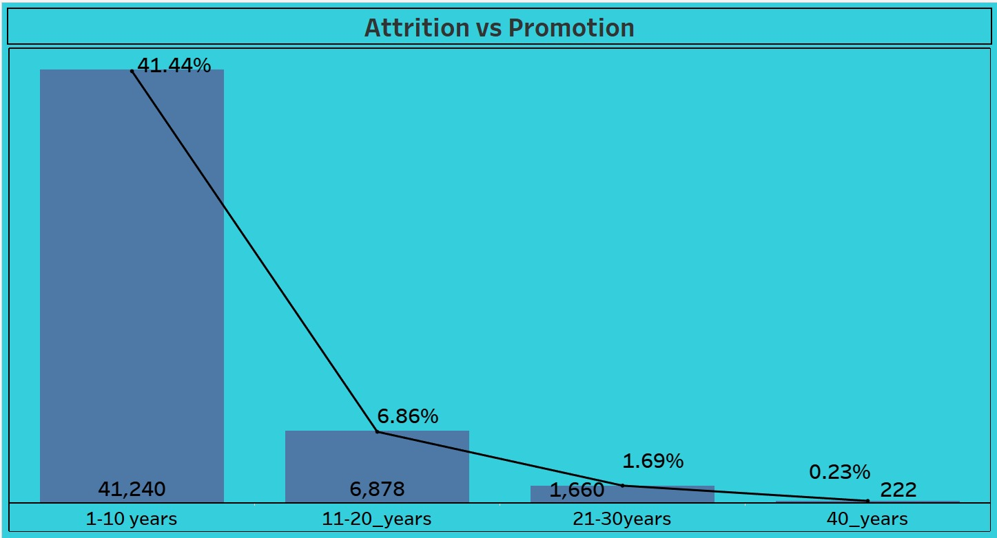
KPI 4:Attrition Rate vs Year Since Last Promotion Relation
Observation:
Inverse Relationship Between Promotion and Attrition:
Attrition decreases with years since the last promotion
Highest at 40% (1-10 years post-promotion), dropping to 0.23% at 30+ years
Conclusion:
Clear link between promotion timelines and attrition rates
Emphasize timely recognition and career progression.

Slide 7

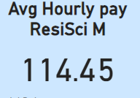
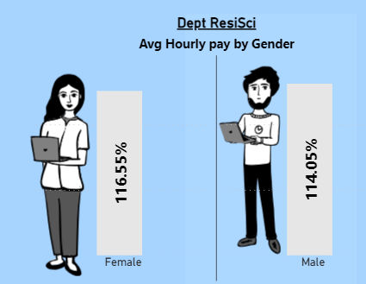
KPI 5 :Average Hourly rate of Male Research Scientist
🤔Observation
Female research scientists outearn their male counterparts in average hourly pay.
On further analysis found that the survey of job satisfaction which stated that males have given rating of 2 out of 5 where as females are 4 out of 5.
The OT hourly pay of males is less than that of females
The distance travelled by males is more as compared to females..
🙂Conclusion
Job Vibes: Let’s have regular heart-to-hearts to vibe check job satisfaction.
Commute: How about flexi-work or ride assists to chill the commute stress.
OT Pay: Equal pay for overtime, cause fair’s fair.
Pay Transparency: Let’s keep it 100 about pay scales.
People Analytics: Let’s deep dive into data to spot and fix pay gaps.
These measures aim to create a more equitable, satisfying, and efficient workplace. 😊

Slide 8

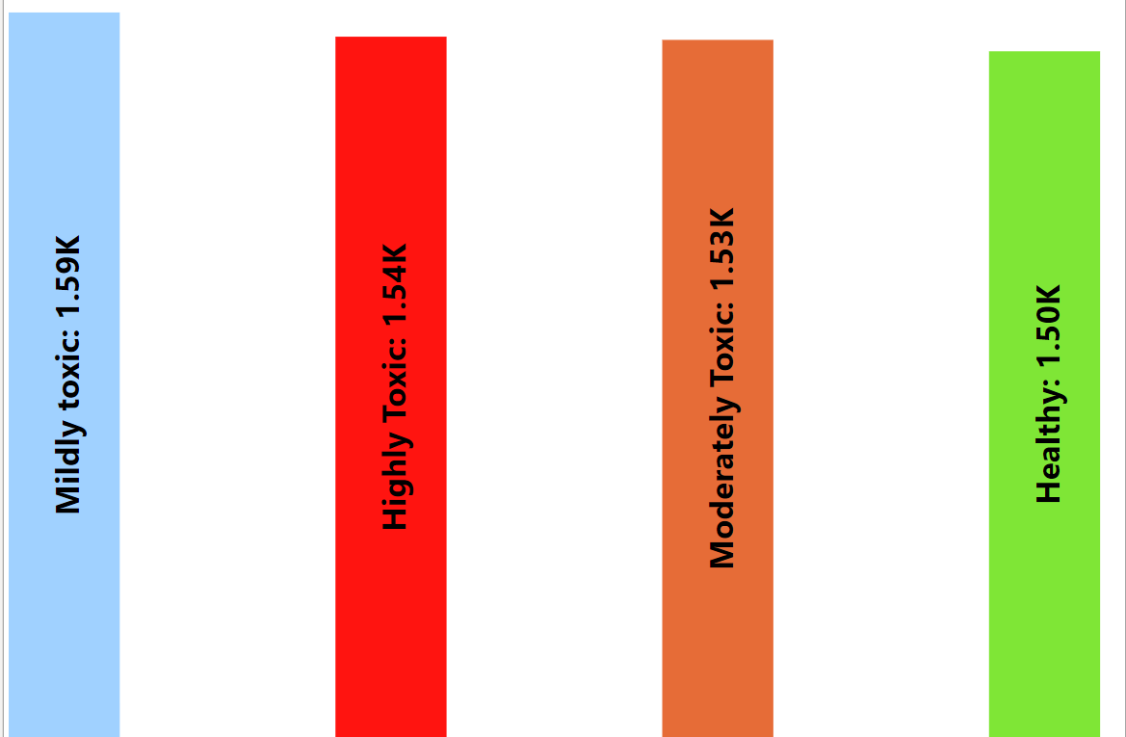
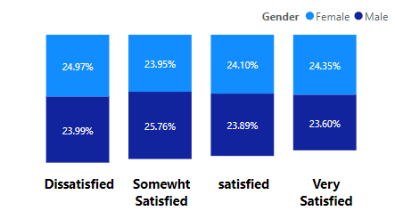
KPI 6: Job Role Vs Work life balance
🤔Observation
Toxic Environment: 1.54K retained employees rate the job environment as highly toxic.
Job Dissatisfaction: 23.99% of males and 24.97% of females are dissatisfied with their jobs.
Burnout: Over 49% of employees in Sales Exec, Sales, and HR departments feel burnt out.
Attrition Rate: Sales department leads with a 5.09% attrition rate.
🙂Conclusion
Improve Work Environment: Implement policies to address toxicity in the working teams premises.
Work Environment: Let’s vibe check the workplace. Conflict resolution training, anonymous feedback, and team-building activities are the way to go.
Job Satisfaction: Regular surveys to catch the feels, career growth opportunities, and shout-outs for achievements to keep the morale high.
Burnout: Flexi-hours, regular chill breaks, and mental health resources for that work-life balance.
Attrition: Keep the compensation packages on point and create a company culture that’s all about feeling valued and engaged.
Let’s make the workplace a better space! 😊

Slide 9
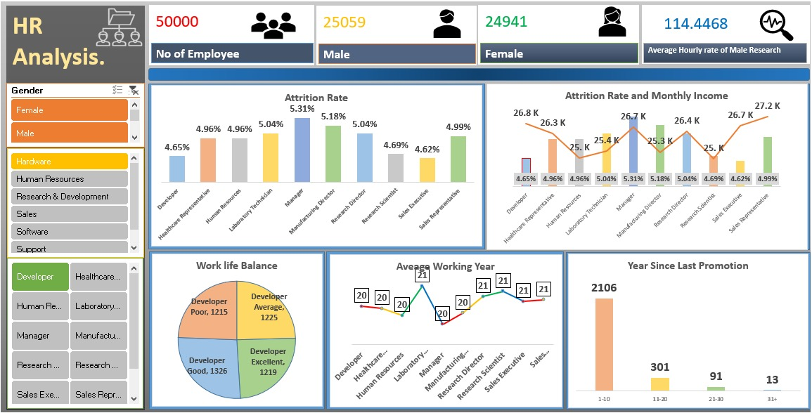
Excel Dashboard

Slide 10
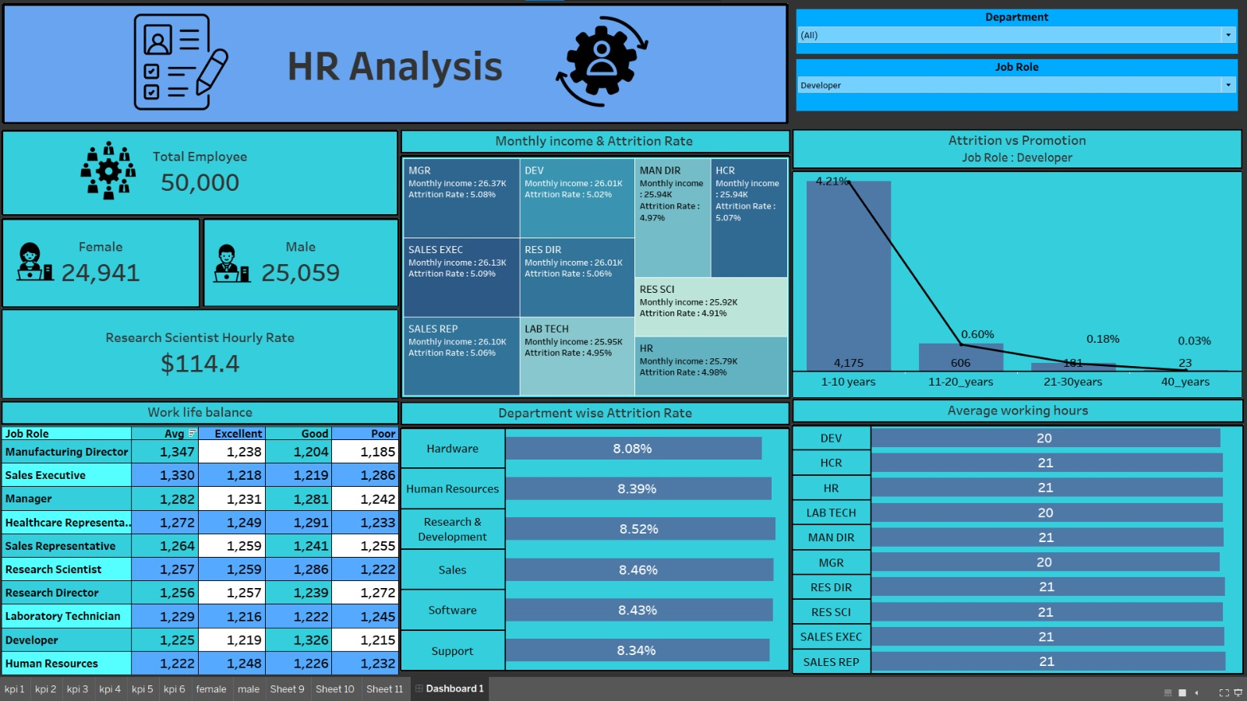
Tableau Dashboard

Slide 11
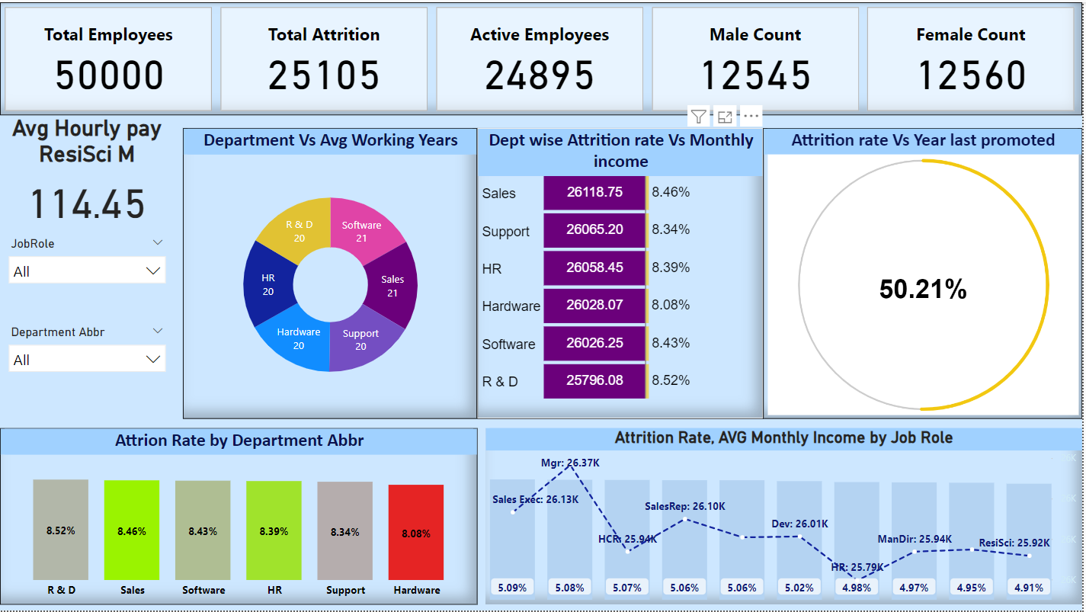
Power BI Dashboard

Slide 12
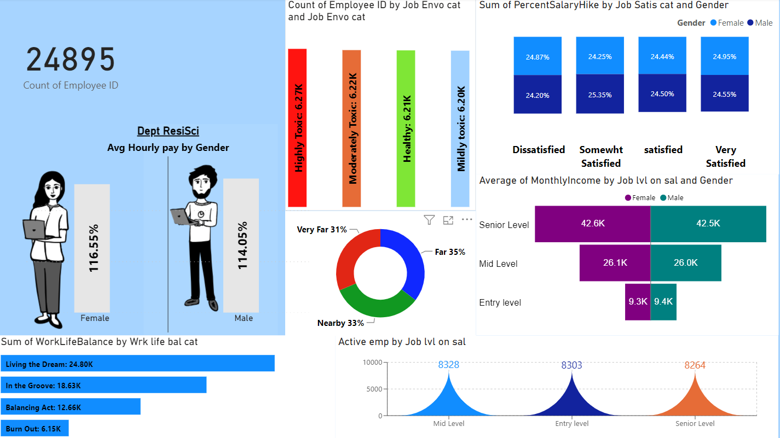
Power BI Dashboard

Slide 13
Challenges
Data Cleaning Complexity:
- Managing excessively long names required aliasing for clarity.
KPI Adjustment in Excel:
- Created bins for Work-Life Balance and Year Since Last Promotion for better categorization.
Database Connectivity Issues:
- Overcame initial challenges connecting MySQL to Tableau and Power BI.
Advanced Functions in Power BI:
- Utilized DAX functions for complex calculations in Power BI.
- Used DAX function to create custom label in order to get rid of axis labels.
Tableau's Calculated Fields:
- Addressed challenges using calculated fields and parameters for dynamic calculations
Team Collaboration:
- Emphasized teamwork in overcoming challenges and achieving project success.
- Mix it up! Different peeps, different skills, equals fresh ideas.
- Digital tools are the game-changer. Work together, anytime, anywhere.

Slide 14
Summary
Data Integration and Cleaning
Dashboard Development:
KPI Categorization:
Collaborative Data Analysis
Strategic Aliasing:
Connectivity Optimization

Slide 15
THANK YOU

